Slide 1
國立金門大學 智慧物聯網實務與應用 Ameba 8195AM 溫濕度曲線視覺化
講師：曹永忠
國立金門大學-工業工程與管理學系
日期：106年6月24~25日

Slide 2
Arduino 程式介紹

Slide 3
Arduino 程式架構
2017/6/24
3

Slide 4
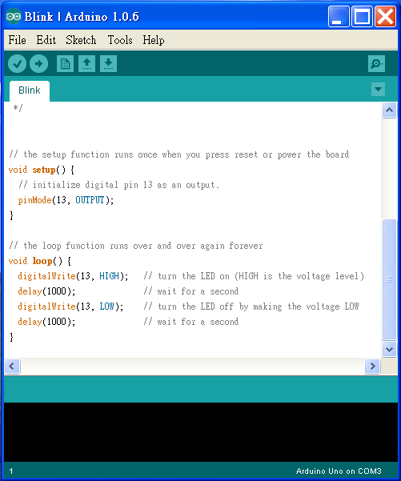
Arduino程式的介面
功能表

Slide 5
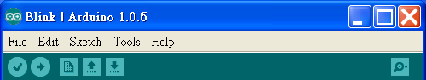
將程式燒入到
Arduino
開啟舊檔
回傳值
同等於C語言的Rebuild All
儲存檔案
開新檔案

Slide 6
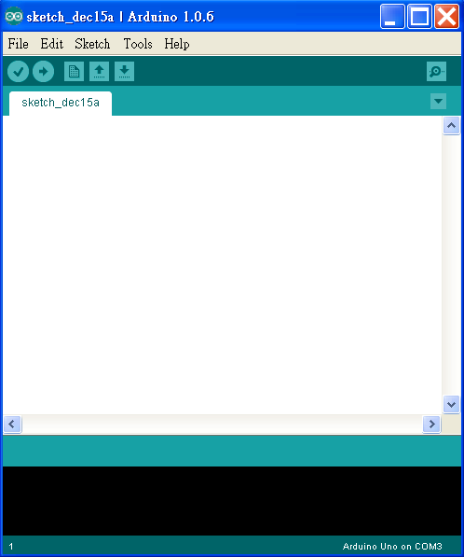
撰寫程式內容
要注意是否連線，
若未連線可以Rebuild但不可燒入

Slide 7
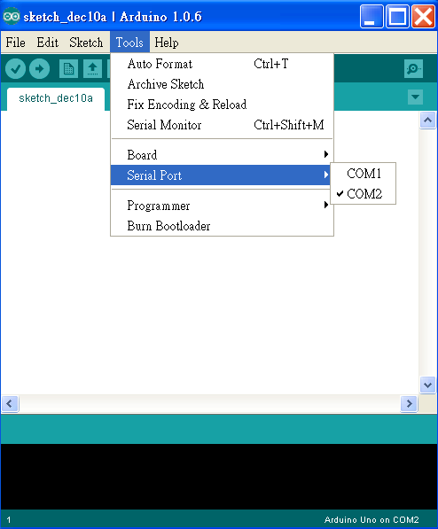
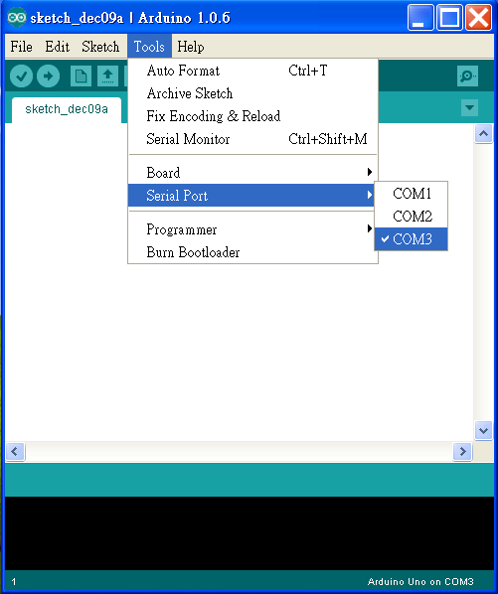
未連線
已連線

Slide 8
Arduino程式架構
(一.)宣告:
Arduino宣告方式與C相同,例如:int，float…
(二.)初始化 Setup():
使Arduino板子裝置妥當的指令
EX:
int ledPin=7; / 宣告Arduino7號腳為輸入腳/
Setup()
{
pinMode(ledPin,INPUT);
}

Slide 9
(三.)執行Loop():
為程式的主要內容,這程式內容會一直重複被執行
EX:
Loop()
{
……
}

Slide 10
(四.)函式:
1. pinMode(7,INPUT) //將腳位7設定為輸入模式
2. digitalWrite(8,HIGH) (數位腳專用)
//將腳位8設定輸出高電位
3. val=digitalRead(7) (數位腳專用)
//讀出腳位7的值並指定給 val變數

Slide 11
4.analogWrite(9,128) (數位訊號專用所設計的函式)
//將擁有PWM的數位腳位9 設定輸出電位2.5V對應值大 約為128
5. val=analogRead(0) (類比腳專用) //讀出腳位0的值並指定給 val變數(且analogRead可讀 取範圍0(0V)~1023(5V))

Slide 12
系統開發
2017/6/24
12

Slide 13
啟動開發環境
2017/6/24
13

Slide 14
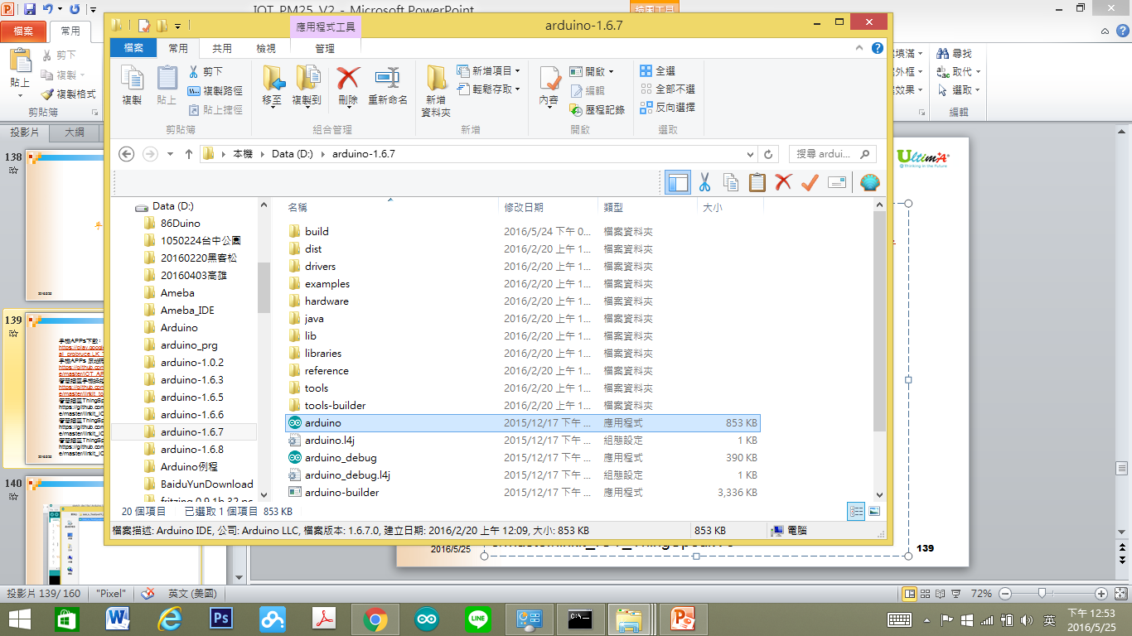
開啟程式
2017/6/24
14

Slide 15

啟動程式
2017/6/24
15

Slide 16
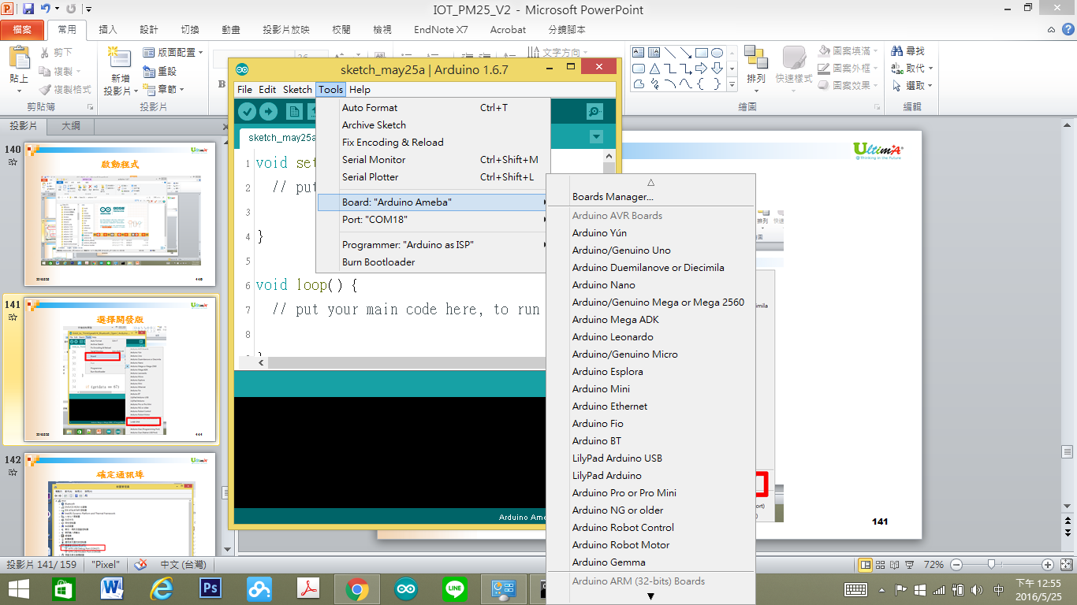
選擇開發版
2017/6/24
16

Slide 17
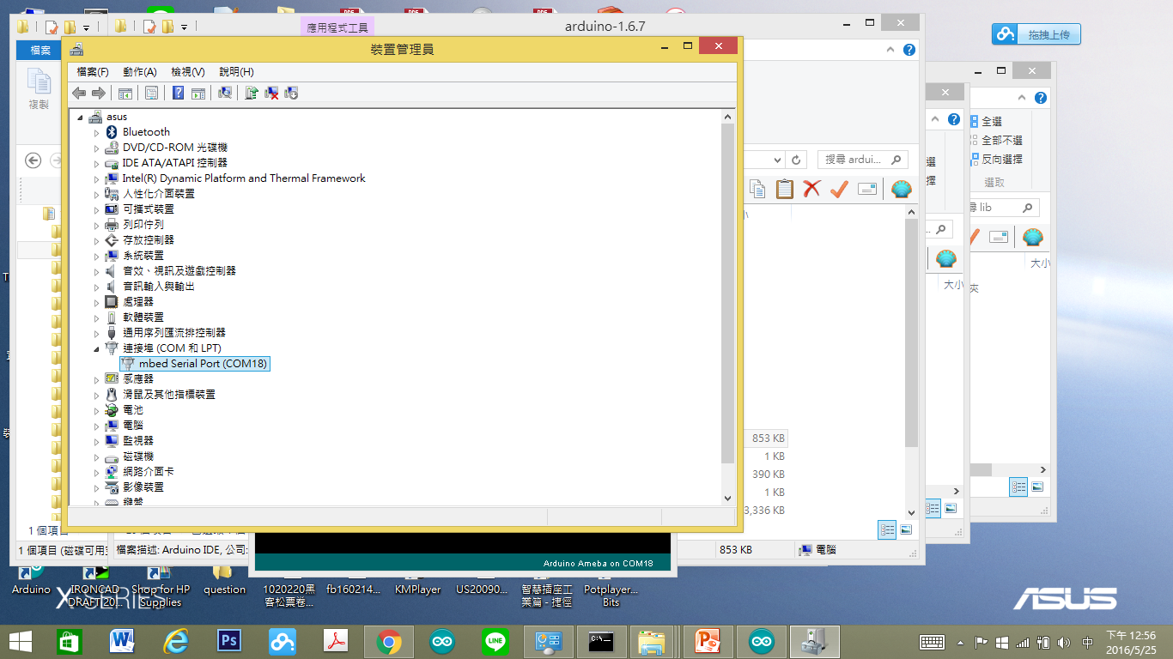
確定通訊埠
2017/6/24
17

Slide 18
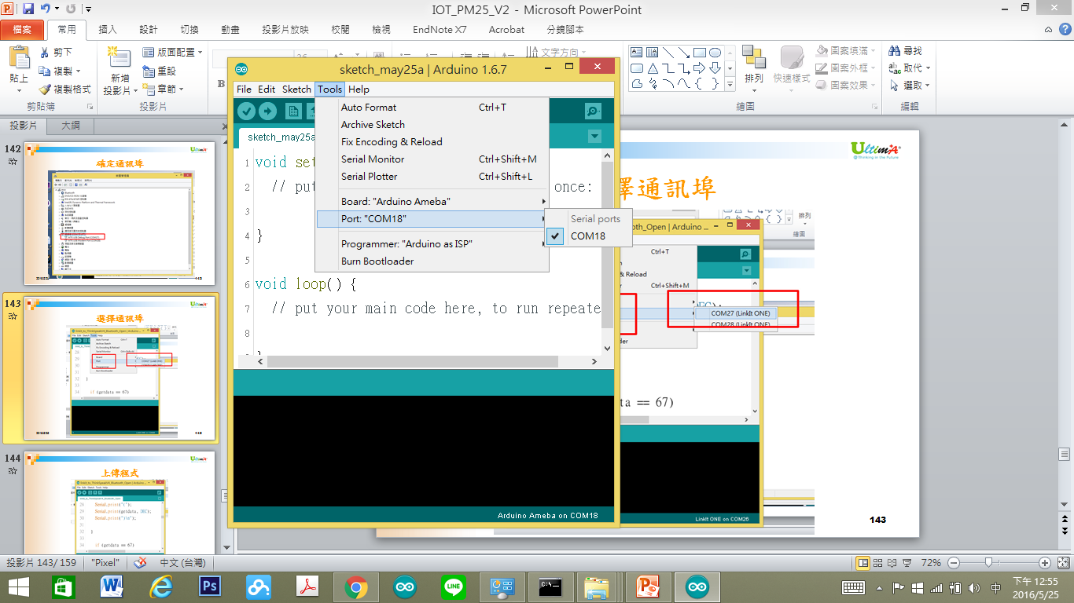
選擇通訊埠
2017/6/24
18

Slide 19
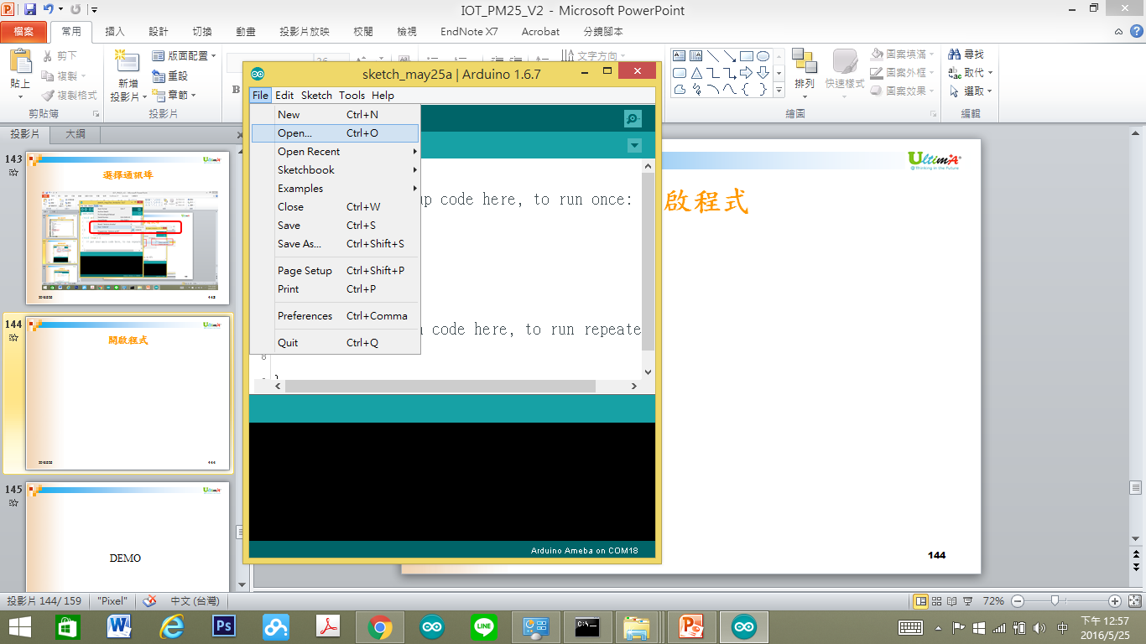
開啟程式
2017/6/24
19

Slide 20
Ameba 腳位說明
2017/6/24
20

Slide 21
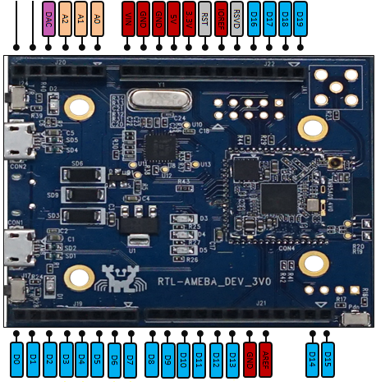
2017/6/24
21

Slide 22
溫濕度感測元件
2017/6/24
22

Slide 23
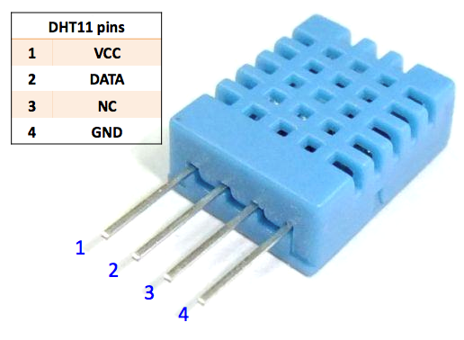
溫濕度元件
2017/6/24
23

Slide 24
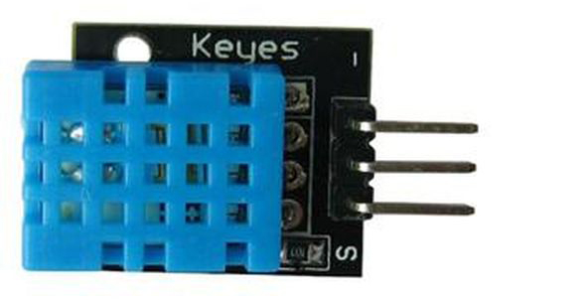
溫濕度模組
2017/6/24
24

Slide 25
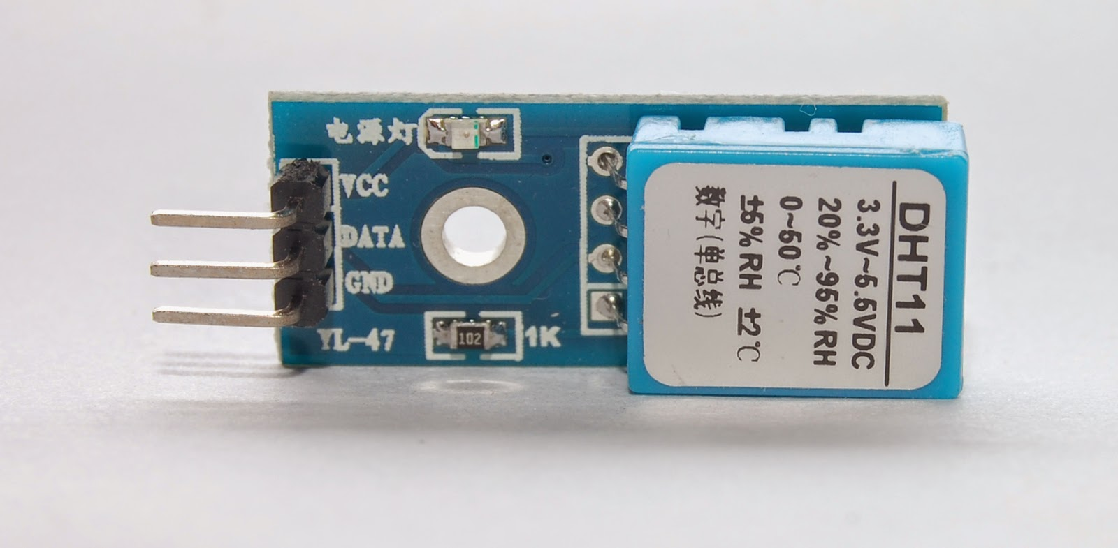
溫濕度模組
2017/6/24
25

Slide 26
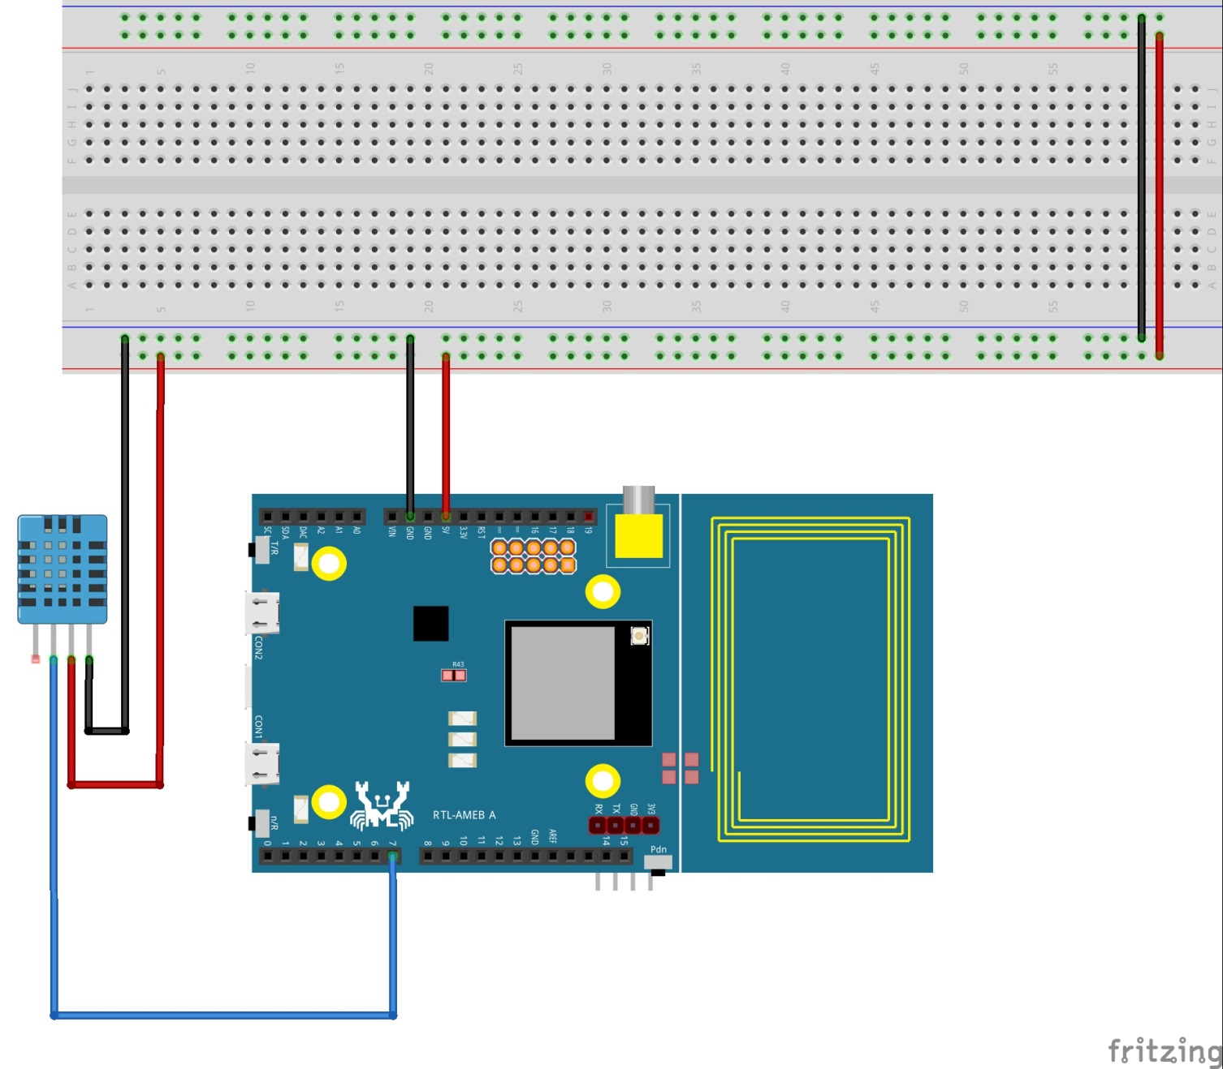
DHT連接電路
2017/6/24
26

Slide 27
Coding
2017/6/24
27

Slide 28
讀取溫濕度資料
2017/6/24
28

Slide 29
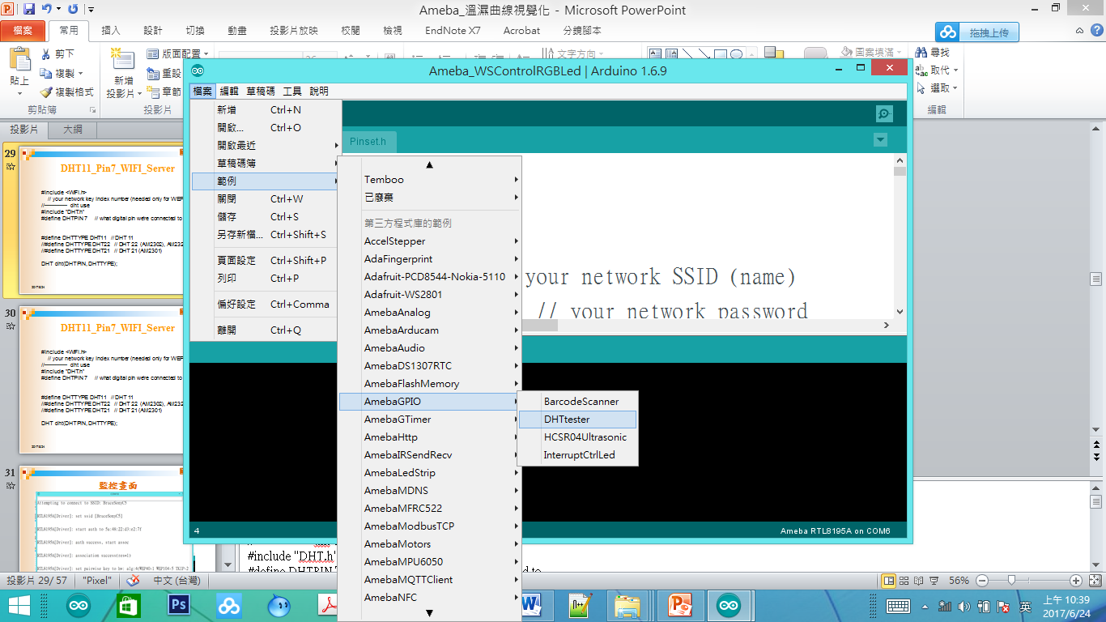
DHTtESTER
2017/6/24
29
Notes:
#include <WiFi.h>
// your network key Index number (needed only for WEP)
//-------------- dht use
#include "DHT.h"
#define DHTPIN 7 // what digital pin we're connected to
#define DHTTYPE DHT11 // DHT 11
//#define DHTTYPE DHT22 // DHT 22 (AM2302), AM2321
//#define DHTTYPE DHT21 // DHT 21 (AM2301)
DHT dht(DHTPIN, DHTTYPE);
//----wifi use
uint8_t MacData[6];
char ssid[] = "BruceSonyC5"; // your network SSID (name)
char pass[] = "12345678"; // your network password
int keyIndex = 0;
IPAddress Meip ,Megateway ,Mesubnet ;
String MacAddress ;
int status = WL_IDLE_STATUS;
WiFiServer server(80);
//-----end of wifi use
void setup() /*----( SETUP: RUNS ONCE )----*/
{
Serial.begin(9600);
Serial.println("DHTxx test!");
dht.begin();
if (WiFi.status() == WL_NO_SHIELD) {
Serial.println("WiFi shield not present");
// don't continue:
while (true);
}
String fv = WiFi.firmwareVersion();
if (fv != "1.1.0") {
Serial.println("Please upgrade the firmware");
}
MacAddress = GetWifiMac() ; // get MacAddress
ShowMac() ; //Show Mac Address
// attempt to connect to Wifi network:
initializeWiFi();
server.begin();
// you're connected now, so print out the status:
ShowInternetStatus();
}// END Setup
static int count=0;
void loop()
{
// Reading temperature or humidity takes about 250 milliseconds!
// Sensor readings may also be up to 2 seconds 'old' (its a very slow sensor)
float h = dht.readHumidity();
// Read temperature as Celsius (the default)
float t = dht.readTemperature();
// Read temperature as Fahrenheit (isFahrenheit = true)
float f = dht.readTemperature(true);
Serial.print("Humidity: ");
Serial.print(h);
Serial.print(" % and ");
Serial.print("Temperature: ");
Serial.print(t);
Serial.print(" *C ");
Serial.print(f);
Serial.print(" *F\t\n");
// wifi code here
// listen for incoming clients
WiFiClient client = server.available();
if (client)
{
Serial.println("Now Someone Access WebServer");
Serial.println("new client");
// an http request ends with a blank line
boolean currentLineIsBlank = true;
while (client.connected())
{
if (client.available())
{
char c = client.read();
Serial.write(c);
// if you've gotten to the end of the line (received a newline
// character) and the line is blank, the http request has ended,
// so you can send a reply
if (c == '\n' && currentLineIsBlank)
{
// send a standard http response header
client.println("HTTP/1.1 200 OK");
client.println("Content-Type: text/html");
client.println("Connection: close"); // the connection will be closed after completion of the response
client.println("Refresh: 5"); // refresh the page automatically every 5 sec
client.println();
client.println("<!DOCTYPE HTML>");
client.println("<html>");
// output the value of each analog input pin
client.print("Humidity: ");
client.print(h);
client.print(" % and ");
client.print("Temperature: ");
client.print(t);
client.print("*C and ");
client.print(f);
client.print("*F (end) ");
client.println("<br />");
client.println("</html>");
break;
}
if (c == '\n')
{
// you're starting a new line
currentLineIsBlank = true;
} else if (c != '\r')
{
// you've gotten a character on the current line
currentLineIsBlank = false;
}
}
}
// give the web browser time to receive the data
delay(1);
// close the connection:
client.stop();
Serial.println("client disonnected");
}
} // END Loop
void ShowMac()
{
Serial.print("MAC:");
Serial.print(MacAddress);
Serial.print("\n");
}
String GetWifiMac()
{
String tt ;
String t1,t2,t3,t4,t5,t6 ;
WiFi.status(); //this method must be used for get MAC
WiFi.macAddress(MacData);
Serial.print("Mac:");
Serial.print(MacData[0],HEX) ;
Serial.print("/");
Serial.print(MacData[1],HEX) ;
Serial.print("/");
Serial.print(MacData[2],HEX) ;
Serial.print("/");
Serial.print(MacData[3],HEX) ;
Serial.print("/");
Serial.print(MacData[4],HEX) ;
Serial.print("/");
Serial.print(MacData[5],HEX) ;
Serial.print("~");
t1 = print2HEX((int)MacData[0]);
t2 = print2HEX((int)MacData[1]);
t3 = print2HEX((int)MacData[2]);
t4 = print2HEX((int)MacData[3]);
t5 = print2HEX((int)MacData[4]);
t6 = print2HEX((int)MacData[5]);
tt = (t1+t2+t3+t4+t5+t6) ;
Serial.print(tt);
Serial.print("\n");
return tt ;
}
String print2HEX(int number) {
String ttt ;
if (number >= 0 && number < 16)
{
ttt = String("0") + String(number,HEX);
}
else
{
ttt = String(number,HEX);
}
return ttt ;
}
void printWifiData()
{
// print your WiFi shield's IP address:
Meip = WiFi.localIP();
Serial.print("IP Address: ");
Serial.println(Meip);
Serial.print("\n");
// print your MAC address:
byte mac[6];
WiFi.macAddress(mac);
Serial.print("MAC address: ");
Serial.print(mac[5], HEX);
Serial.print(":");
Serial.print(mac[4], HEX);
Serial.print(":");
Serial.print(mac[3], HEX);
Serial.print(":");
Serial.print(mac[2], HEX);
Serial.print(":");
Serial.print(mac[1], HEX);
Serial.print(":");
Serial.println(mac[0], HEX);
// print your subnet mask:
Mesubnet = WiFi.subnetMask();
Serial.print("NetMask: ");
Serial.println(Mesubnet);
// print your gateway address:
Megateway = WiFi.gatewayIP();
Serial.print("Gateway: ");
Serial.println(Megateway);
}
void ShowInternetStatus()
{
if (WiFi.status())
{
Meip = WiFi.localIP();
Serial.print("Get IP is:");
Serial.print(Meip);
Serial.print("\n");
}
else
{
Serial.print("DisConnected:");
Serial.print("\n");
}
}
void initializeWiFi() {
while (status != WL_CONNECTED) {
Serial.print("Attempting to connect to SSID: ");
Serial.println(ssid);
// Connect to WPA/WPA2 network. Change this line if using open or WEP network:
status = WiFi.begin(ssid, pass);
// status = WiFi.begin(ssid);
// wait 10 seconds for connection:
delay(10000);
}
Serial.print("\n Success to connect AP:") ;
Serial.print(ssid) ;
Serial.print("\n") ;
}

Slide 30
DHT11_Pin7_WIFI_Server
#include "DHT.h"
#define DHTPIN 2 // what digital pin we're connected to
// Uncomment whatever type you're using!
//#define DHTTYPE DHT11 // DHT 11
#define DHTTYPE DHT22 // DHT 22 (AM2302), AM2321
//#define DHTTYPE DHT21 // DHT 21 (AM2301)
2017/6/24
30
Notes:
// Example testing sketch for various DHT humidity/temperature sensors
// Written by ladyada, public domain
#include "DHT.h"
#define DHTPIN 2 // what digital pin we're connected to
// Uncomment whatever type you're using!
//#define DHTTYPE DHT11 // DHT 11
#define DHTTYPE DHT22 // DHT 22 (AM2302), AM2321
//#define DHTTYPE DHT21 // DHT 21 (AM2301)
// Connect pin 1 (on the left) of the sensor to +5V
// NOTE: If using a board with 3.3V logic like an Arduino Due connect pin 1
// to 3.3V instead of 5V!
// Connect pin 2 of the sensor to whatever your DHTPIN is
// Connect pin 4 (on the right) of the sensor to GROUND
// Connect a 10K resistor from pin 2 (data) to pin 1 (power) of the sensor
// Initialize DHT sensor.
// Note that older versions of this library took an optional third parameter to
// tweak the timings for faster processors. This parameter is no longer needed
// as the current DHT reading algorithm adjusts itself to work on faster procs.
DHT dht(DHTPIN, DHTTYPE);
void setup() {
Serial.begin(9600);
Serial.println("DHTxx test!");
dht.begin();
}
void loop() {
// Wait a few seconds between measurements.
delay(2000);
// Reading temperature or humidity takes about 250 milliseconds!
// Sensor readings may also be up to 2 seconds 'old' (its a very slow sensor)
float h = dht.readHumidity();
// Read temperature as Celsius (the default)
float t = dht.readTemperature();
// Read temperature as Fahrenheit (isFahrenheit = true)
float f = dht.readTemperature(true);
// Check if any reads failed and exit early (to try again).
if (isnan(h) || isnan(t) || isnan(f)) {
Serial.println("Failed to read from DHT sensor!");
return;
}
// Compute heat index in Fahrenheit (the default)
float hif = dht.computeHeatIndex(f, h);
// Compute heat index in Celsius (isFahreheit = false)
float hic = dht.computeHeatIndex(t, h, false);
Serial.print("Humidity: ");
Serial.print(h);
Serial.print(" %\t");
Serial.print("Temperature: ");
Serial.print(t);
Serial.print(" *C ");
Serial.print(f);
Serial.print(" *F\t");
Serial.print("Heat index: ");
Serial.print(hic);
Serial.print(" *C ");
Serial.print(hif);
Serial.println(" *F");
}

Slide 31
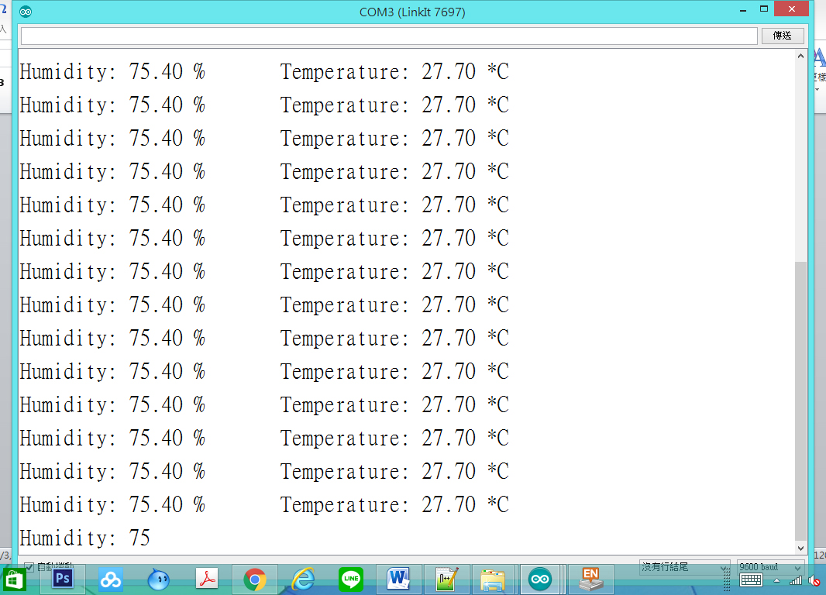
監控畫面
2017/6/24
31

Slide 32
如何視覺化
2017/6/24
32

Slide 33

使用Google Developer資源
2017/6/24
33
Notes:
https://developers.google.com/chart/interactive/docs/gallery

Slide 34
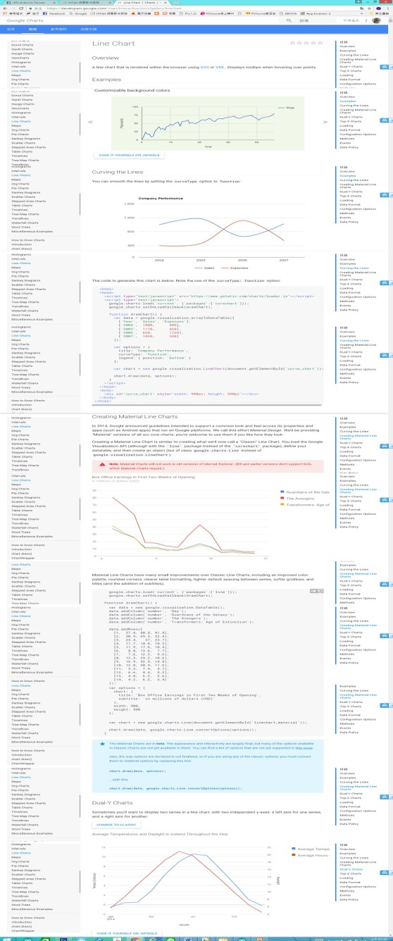
使用Line Chart視覺化技術
2017/6/24
34

Slide 35
使用Line Chart視覺化技術
2017/6/24
35

Slide 36
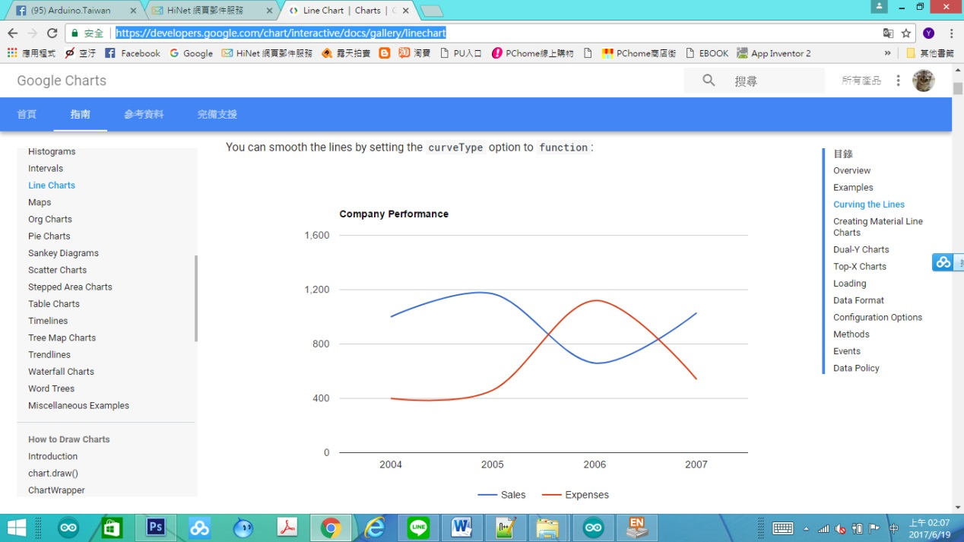
使用Line Chart視覺化技術
2017/6/24
36

Slide 37
Line Chart視覺化重點解說
<script type="text/javascript" src="https://www.gstatic.com/charts/loader.js"></script>
<script type="text/javascript">
google.charts.load('current', {'packages':['corechart']});
google.charts.setOnLoadCallback(drawChart);
使用Google 資源
載入Google Chart 資源
2017/6/24
37
Notes:
<html>
<head>
<script type="text/javascript" src="https://www.gstatic.com/charts/loader.js"></script>
<script type="text/javascript">
google.charts.load('current', {'packages':['corechart']});
google.charts.setOnLoadCallback(drawChart);
function drawChart() {
var data = google.visualization.arrayToDataTable([
['Year', 'Sales', 'Expenses'],
['2004', 1000, 400],
['2005', 1170, 460],
['2006', 660, 1120],
['2007', 1030, 540]
]);
var options = {
title: 'Company Performance',
curveType: 'function',
legend: { position: 'bottom' }
};
var chart = new google.visualization.LineChart(document.getElementById('curve_chart'));
chart.draw(data, options);
}
</script>
</head>
<body>
<div id="curve_chart" style="width: 900px; height: 500px"></div>
</body>
</html>

Slide 38
Line Chart視覺化重點解說
function drawChart() {
var data = google.visualization.arrayToDataTable([
['Year', 'Sales', 'Expenses'],
['2004', 1000, 400],
['2005', 1170, 460],
['2006', 660, 1120],
['2007', 1030, 540]
]);
[‘Label’, ‘Value’]➔資料標題
第二列的[‘2004,1000,400] 為資料第一筆，
前面為資料名稱，後面資料內容
2017/6/24
38

Slide 39
Line Chart視覺化重點解說
var options = {
title: 'Company Performance',
curveType: 'function',
legend: { position: 'bottom' }
};
width: ， height 為 每一個Line Chart的寬與高
title: Line Chart圖形的標題內容。
2017/6/24
39
Notes:
由下表所示，我們可以了解，必須將『 https://www.gstatic.com/charts/loader.js』 的Google 網路元件的資源載入。

Slide 40
Line Chart視覺化重點解說
var chart = new google.visualization.LineChart(document.getElementById('curve_chart'));
chart.draw(data, options);
var chart = new google.visualization.LineChart(document.getElementById('curve_chart'));➔產生Line Chart圖形
2017/6/24
40

Slide 41
Line Chart視覺化重點解說
<body>
<div id="chart_div" style="width: 800px; height: 800px;"></div>
</body>
<div id=“chart_div” style=“width: 800px; height: 800px;”></div>➔產生叫” chart_div”的 繪圖空間
width: 800px 繪圖空間寬度
height: 800px;繪圖空間高度
chart.draw(data, options);➔畫出Line Chart圖形
2017/6/24
41

Slide 42
真正產生瀏覽器動作命令
<body>
<div id="curve_chart" style="width: 900px; height: 500px"></div>
</body>
<div id="curve_chart" style="width: 900px; height: 500px"></div>➔產生叫” curve_chart的 繪圖空間
width: 900px 繪圖空間寬度
height: 500px;繪圖空間高度
2017/6/24
42

Slide 43
Line Chart視覺化程式開發
2017/6/24
43

Slide 44
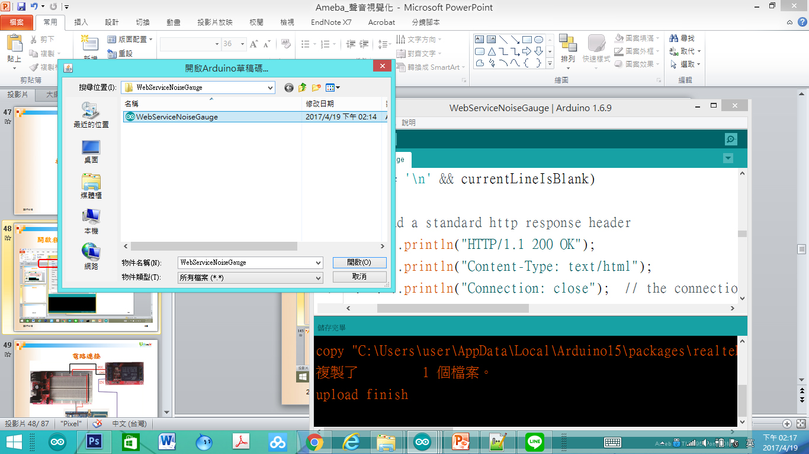
開啟程式DHT22_WIFI_Server_LineChart
2017/6/24
44

Slide 45
DHT22_WIFI_Server_LineChart
#include <WiFi.h>
#define delaytime 4000
#include "DHT.h"
#define DHTPIN 8 // what digital pin we're connected to
//#define DHTTYPE DHT11 // DHT 11
#define DHTTYPE DHT22 // DHT 22 (AM2302), AM2321
//#define DHTTYPE DHT21 // DHT 21 (AM2301)
DHT dht(DHTPIN, DHTTYPE);
2017/6/24
45
Notes:
#include <WiFi.h>
#define delaytime 4000
#include "DHT.h"
#define DHTPIN 8 // what digital pin we're connected to
//#define DHTTYPE DHT11 // DHT 11
#define DHTTYPE DHT22 // DHT 22 (AM2302), AM2321
//#define DHTTYPE DHT21 // DHT 21 (AM2301)
DHT dht(DHTPIN, DHTTYPE);
char ssid[] = "IOT"; // your network SSID (name)
char pass[] = "iot12345"; // your network password
int status = WL_IDLE_STATUS; // the Wifi radio's status
IPAddress Meip , Megateway , Mesubnet ;
String MacAddress ;
uint8_t MacData[6];
WiFiServer server(80);
//-----end of wifi use
// store Temperature data as array
#define MaxData 20
float tempdata1[20] ;
float tempdata2[20] ;
int dataCount = 0 ;
void setup() {
//Initialize serial and wait for port to open:
Serial.begin(9600);
Serial.println("DHTxx test!");
dht.begin();
while (!Serial) {
; // wait for serial port to connect. Needed for native USB port only
}
MacAddress = GetWifiMac() ; // get MacAddress
ShowMac() ; //Show Mac Address
// attempt to connect to Wifi network:
initializeWiFi();
server.begin();
// you're connected now, so print out the status:
ShowInternetStatus();
}// END Setup
static int count = 0;
void loop() {
// Reading temperature or humidity takes about 250 milliseconds!
// Sensor readings may also be up to 2 seconds 'old' (its a very slow sensor)
float h = dht.readHumidity();
// Read temperature as Celsius (the default)
float t = dht.readTemperature();
// Read temperature as Fahrenheit (isFahrenheit = true)
float f = dht.readTemperature(true);
tempdata1[dataCount] = t ;
dataCount++ ;
if (dataCount >= MaxData)
{
floatArrayCopy(tempdata1,tempdata2,MaxData) ;
dataCount = 0 ;
// data is fulled and copy into showarray
}
// wifi code here>=
// listen for incoming clients
WiFiClient client = server.available();
if (client)
{
Serial.println("Now Someone Access WebServer");
Serial.println("new client");
// an http request ends with a blank line
boolean currentLineIsBlank = true;
while (client.connected())
{
if (client.available())
{
char c = client.read();
Serial.write(c);
// if you've gotten to the end of the line (received a newline
// character) and the line is blank, the http request has ended,
// so you can send a reply
if (c == '\n' && currentLineIsBlank)
{
// send a standard http response header
client.println("HTTP/1.1 200 OK");
client.println("Content-Type: text/html");
client.println("Connection: close"); // the connection will be closed after completion of the response
client.println("Refresh: 5"); // refresh the page automatically every 5 sec
client.println();
client.println("<!DOCTYPE HTML>");
client.println("<html>");
// output the value of each analog input pin
client.println(" <head>");
client.println(" <script type='text/javascript' src='https://www.gstatic.com/charts/loader.js'></script>");
client.println(" <script type='text/javascript'>");
client.println("google.charts.load('current', {'packages':['corechart']});");
client.println("google.charts.setOnLoadCallback(drawChart);");
client.println(" function drawChart() {");
client.print("var data = google.visualization.arrayToDataTable([['Time', 'Temperature']," );
for (int i = 0 ; i <MaxData; i++)
{
client.print("['") ;
client.print(i);
client.print("',") ;
client.print(tempdata2[i]);
client.print("]") ;
if (i < (MaxData -1))
{
client.print(",") ;
}
}
client.println("]);");
client.println(" var options = {title: '目前溫度',curveType: 'function',legend: { position: 'bottom' }};");
client.println("var chart = new google.visualization.LineChart(document.getElementById('curve_chart'));");
client.println("chart.draw(data, options);");
client.println("}");
client.println("</script>");
client.println("</head>");
client.println("<meta charset='utf-8'>");
client.println("<body>");
client.println("<div id='curve_chart' style='width: 1200px; height: 500px'></div>");
client.println("Now(") ;
client.println(dataCount) ;
client.println(" )<br> ") ;
for (int i=0 ; i <MaxData ; i++)
{
client.println(i) ;
client.println("/") ;
client.println(tempdata1[i]) ;
client.println(" , ") ;
}
client.println("</body>");
/*
client.print("Humidity: ");
client.print(h);
client.print(" % and ");
client.print("Temperature: ");
client.print(t);
client.print("*C and ");
client.print(f);
client.print("*F (end) ");
client.println("<br />");
*/
client.println("</html>");
break;
}
if (c == '\n')
{
// you're starting a new line
currentLineIsBlank = true;
} else if (c != '\r')
{
// you've gotten a character on the current line
currentLineIsBlank = false;
}
}
}
// give the web browser time to receive the data
delay(1);
// close the connection:
client.stop();
Serial.println("client disonnected");
}
delay(delaytime) ;
} // END Loop
void printWifiData() {
// print your WiFi shield's IP address:
IPAddress ip = WiFi.localIP();
Serial.print("IP Address: ");
Serial.println(ip);
Serial.println(ip);
// print your MAC address:
WiFi.macAddress(MacData);
Serial.print("MAC address: ");
Serial.print(MacData[0], HEX);
Serial.print(":");
Serial.print(MacData[1], HEX);
Serial.print(":");
Serial.print(MacData[2], HEX);
Serial.print(":");
Serial.print(MacData[3], HEX);
Serial.print(":");
Serial.print(MacData[4], HEX);
Serial.print(":");
Serial.println(MacData[5], HEX);
}
void initializeWiFi() {
while (status != WL_CONNECTED) {
Serial.print("Attempting to connect to SSID: ");
Serial.println(ssid);
// Connect to WPA/WPA2 network. Change this line if using open or WEP network:
status = WiFi.begin(ssid, pass);
// status = WiFi.begin(ssid);
// wait 10 seconds for connection:
delay(10000);
}
Serial.print("\n Success to connect AP:") ;
Serial.print(ssid) ;
Serial.print("\n") ;
}
void printCurrentNet() {
// print the SSID of the network you're attached to:
Serial.print("SSID: ");
Serial.println(WiFi.SSID());
// print the MAC address of the router you're attached to:
byte bssid[6];
WiFi.BSSID(bssid);
Serial.print("BSSID: ");
Serial.print(bssid[5], HEX);
Serial.print(":");
Serial.print(bssid[4], HEX);
Serial.print(":");
Serial.print(bssid[3], HEX);
Serial.print(":");
Serial.print(bssid[2], HEX);
Serial.print(":");
Serial.print(bssid[1], HEX);
Serial.print(":");
Serial.println(bssid[0], HEX);
// print the received signal strength:
long rssi = WiFi.RSSI();
Serial.print("signal strength (RSSI):");
Serial.println(rssi);
// print the encryption type:
byte encryption = WiFi.encryptionType();
Serial.print("Encryption Type:");
Serial.println(encryption, HEX);
Serial.println();
}
void ShowInternetStatus()
{
if (WiFi.status())
{
Meip = WiFi.localIP();
Serial.print("Get IP is:");
Serial.print(Meip);
Serial.print("\n");
// print your subnet mask:
Mesubnet = WiFi.subnetMask();
Serial.print("NetMask: ");
Serial.println(Mesubnet);
// print your gateway address:
Megateway = WiFi.gatewayIP();
Serial.print("Gateway: ");
Serial.println(Megateway);
}
else
{
Serial.print("DisConnected:");
Serial.print("\n");
}
}
void ShowMac()
{
Serial.print("MAC:");
Serial.print(MacAddress);
Serial.print("\n");
}
String GetWifiMac()
{
String tt ;
String t1, t2, t3, t4, t5, t6 ;
WiFi.status(); //this method must be used for get MAC
WiFi.macAddress(MacData);
Serial.print("Mac:");
Serial.print(MacData[0], HEX) ;
Serial.print("/");
Serial.print(MacData[1], HEX) ;
Serial.print("/");
Serial.print(MacData[2], HEX) ;
Serial.print("/");
Serial.print(MacData[3], HEX) ;
Serial.print("/");
Serial.print(MacData[4], HEX) ;
Serial.print("/");
Serial.print(MacData[5], HEX) ;
Serial.print("~");
t1 = print2HEX((int)MacData[0]);
t2 = print2HEX((int)MacData[1]);
t3 = print2HEX((int)MacData[2]);
t4 = print2HEX((int)MacData[3]);
t5 = print2HEX((int)MacData[4]);
t6 = print2HEX((int)MacData[5]);
tt = (t1 + t2 + t3 + t4 + t5 + t6) ;
Serial.print(tt);
Serial.print("\n");
return tt ;
}
String print2HEX(int number) {
String ttt ;
if (number >= 0 && number < 16)
{
ttt = String("0") + String(number, HEX);
}
else
{
ttt = String(number, HEX);
}
return ttt ;
}
void floatArrayCopy(float *d1 , float *d2, int cnt)
{
for (int i= 0 ; i < cnt; i++)
{
*(d2+i) = *(d1+i) ;
}
}

Slide 46
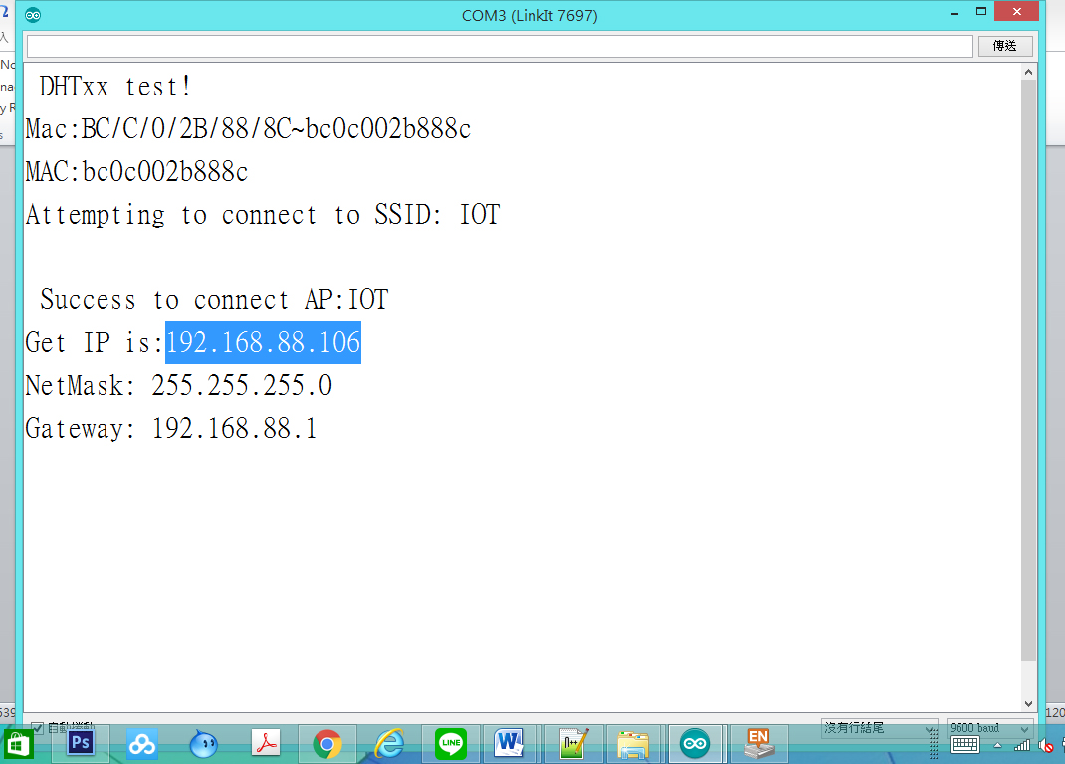
DHT22_WIFI_Server_LineChart監控畫面
2017/6/24
46

Slide 47
使用瀏覽器進入系統
1.先使用筆電或手機，使用wifi，並將ＷＩＦＩ熱點連接到與Ameba相同的熱點
2.進入瀏覽器(建議使用chrome)
3.網址列輸入上面IP(本例子為：192.168.88.106
2017/6/24
47

Slide 48
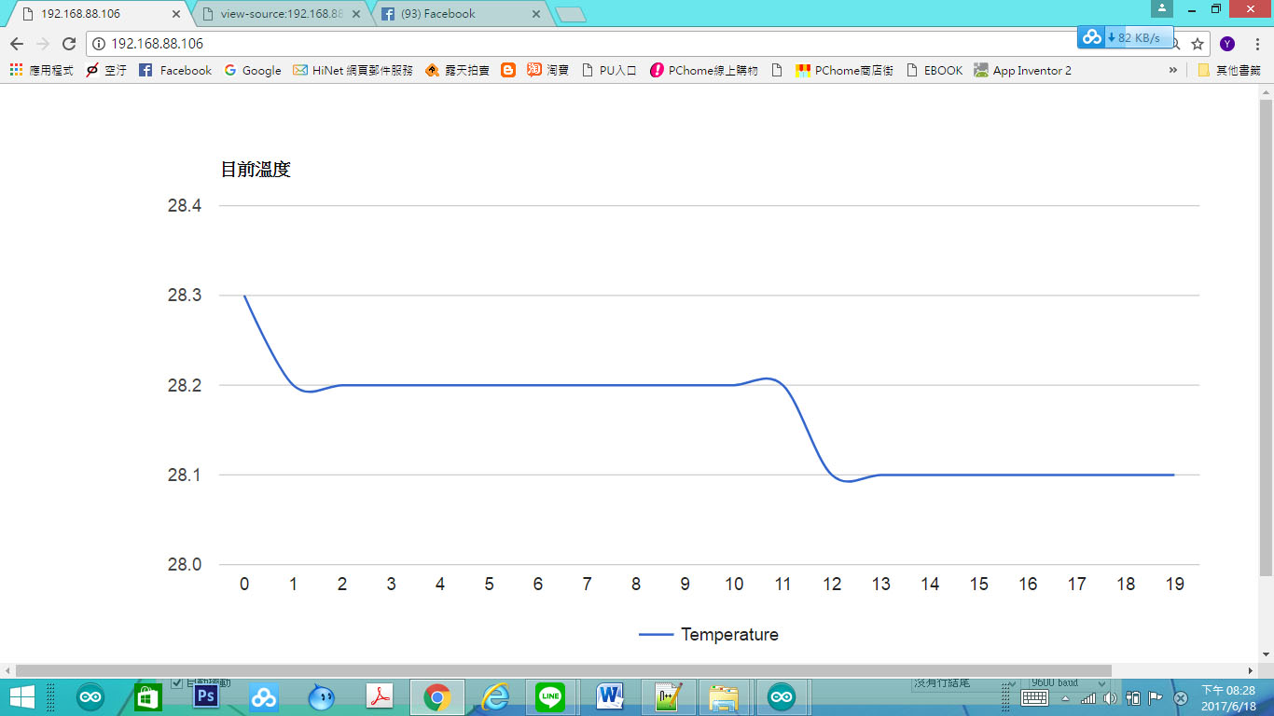
DHT22_WIFI_Server_LineChar網頁畫面
2017/6/24
48

Slide 49
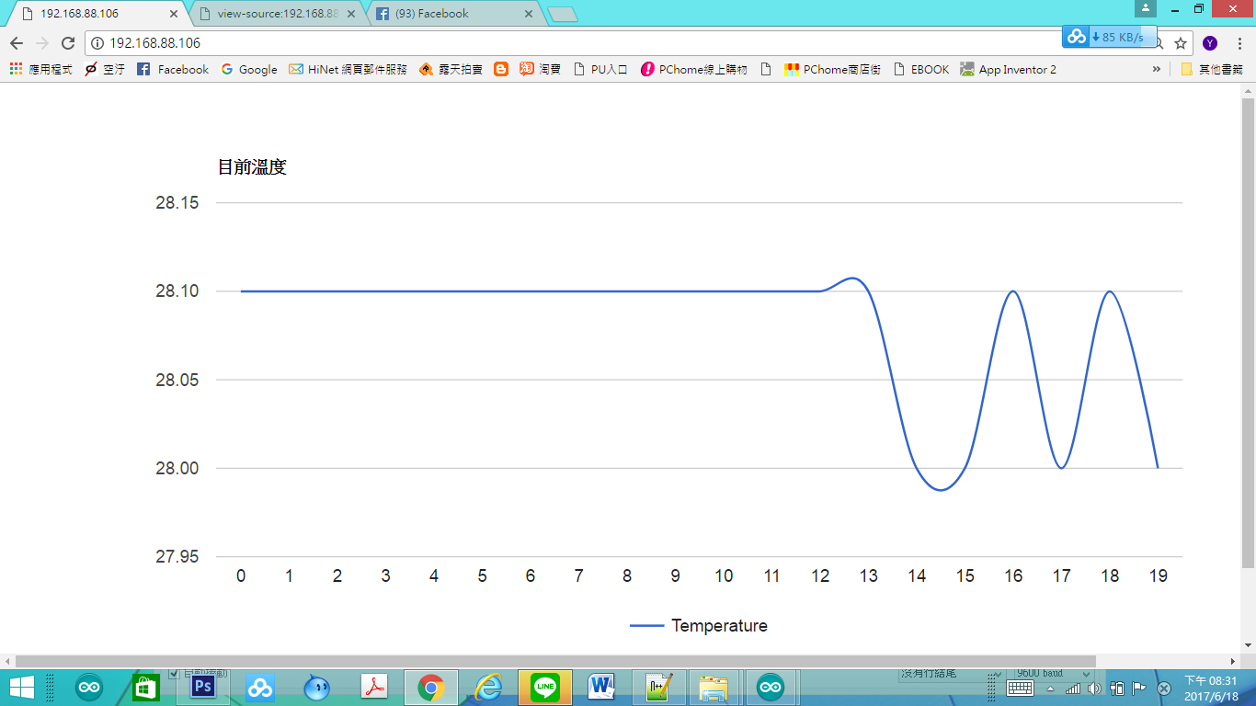
DHT22_WIFI_Server_LineChar網頁畫面
2017/6/24
49

Slide 50
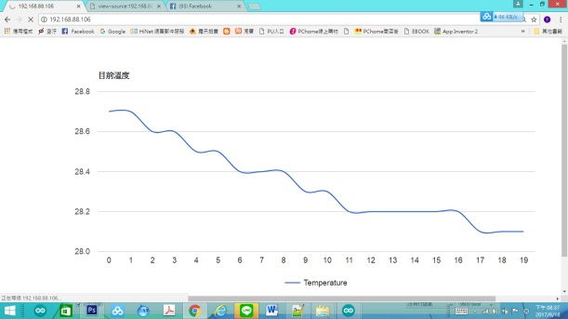
DHT22_WIFI_Server_LineChar網頁畫面
2017/6/24
50

Slide 51
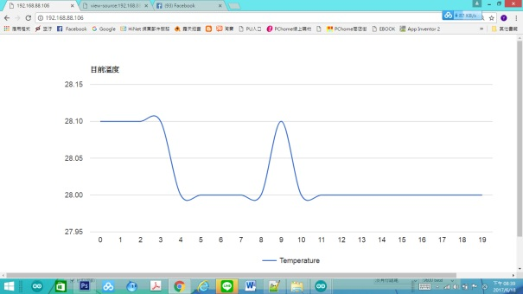
DHT22_WIFI_Server_LineChar網頁畫面
2017/6/24
51

Slide 52
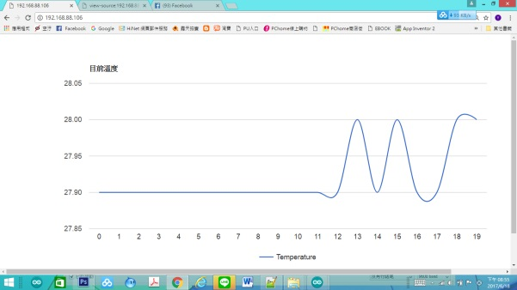
DHT22_WIFI_Server_LineChar網頁畫面
2017/6/24
52

Slide 53
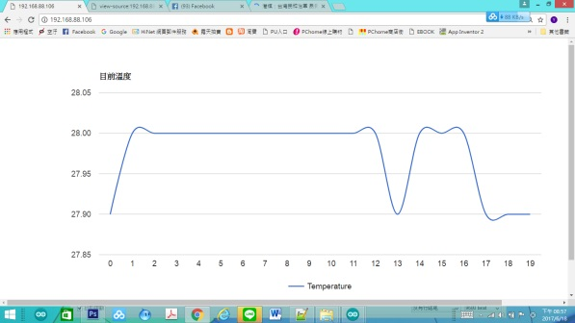
DHT22_WIFI_Server_LineChar網頁畫面
2017/6/24
53

Slide 54
自我練習
2017/6/24
54

Slide 55
習題
請將溫度、濕度的數值都讀出來
溫度顯示在一個Line Chart視覺化抬頭設為:近十次溫度”
2017/6/24
55

Slide 56
Q & A
感謝聆聽
恭請指教

Slide 57
練習解答
2017/6/24
57

Slide 58
開啟程式DHT11_Pin7_WIFI_Server_TwoGuage
2017/6/24
58

Slide 59
DHT11_Pin7_WIFI_Server_TwoGuage
#include <WiFi.h>
// your network key Index number (needed only for WEP)
//-------------- dht use
#include "DHT.h"
#define DHTPIN 7 // what digital pin we're connected to
#define DHTTYPE DHT11 // DHT 11
//#define DHTTYPE DHT22 // DHT 22 (AM2302), AM2321
//#define DHTTYPE DHT21 // DHT 21 (AM2301)
2017/6/24
59
Notes:
#include <WiFi.h>
// your network key Index number (needed only for WEP)
//-------------- dht use
#include "DHT.h"
#define DHTPIN 7 // what digital pin we're connected to
#define DHTTYPE DHT11 // DHT 11
//#define DHTTYPE DHT22 // DHT 22 (AM2302), AM2321
//#define DHTTYPE DHT21 // DHT 21 (AM2301)
DHT dht(DHTPIN, DHTTYPE);
//----wifi use
uint8_t MacData[6];
char ssid[] = "BruceSonyC5"; // your network SSID (name)
char pass[] = "12345678"; // your network password
int keyIndex = 0;
IPAddress Meip , Megateway , Mesubnet ;
String MacAddress ;
int status = WL_IDLE_STATUS;
WiFiServer server(80);
//-----end of wifi use
void setup() /*----( SETUP: RUNS ONCE )----*/
{
Serial.begin(9600);
Serial.println("DHTxx test!");
dht.begin();
if (WiFi.status() == WL_NO_SHIELD) {
Serial.println("WiFi shield not present");
// don't continue:
while (true);
}
String fv = WiFi.firmwareVersion();
if (fv != "1.1.0") {
Serial.println("Please upgrade the firmware");
}
MacAddress = GetWifiMac() ; // get MacAddress
ShowMac() ; //Show Mac Address
// attempt to connect to Wifi network:
initializeWiFi();
server.begin();
// you're connected now, so print out the status:
ShowInternetStatus();
}// END Setup
static int count = 0;
void loop()
{
// Reading temperature or humidity takes about 250 milliseconds!
// Sensor readings may also be up to 2 seconds 'old' (its a very slow sensor)
float h = dht.readHumidity();
// Read temperature as Celsius (the default)
float t = dht.readTemperature();
// Read temperature as Fahrenheit (isFahrenheit = true)
float f = dht.readTemperature(true);
Serial.print("Humidity: ");
Serial.print(h);
Serial.print(" % and ");
Serial.print("Temperature: ");
Serial.print(t);
Serial.print(" *C ");
Serial.print(f);
Serial.print(" *F\t\n");
// wifi code here
// listen for incoming clients
WiFiClient client = server.available();
if (client)
{
Serial.println("Now Someone Access WebServer");
Serial.println("new client");
// an http request ends with a blank line
boolean currentLineIsBlank = true;
while (client.connected())
{
if (client.available())
{
char c = client.read();
Serial.write(c);
// if you've gotten to the end of the line (received a newline
// character) and the line is blank, the http request has ended,
// so you can send a reply
if (c == '\n' && currentLineIsBlank)
{
// send a standard http response header
client.println("HTTP/1.1 200 OK");
client.println("Content-Type: text/html");
client.println("Connection: close"); // the connection will be closed after completion of the response
client.println("Refresh: 5"); // refresh the page automatically every 5 sec
client.println();
client.println("<!DOCTYPE HTML>");
client.println("<html>");
// output the value of each analog input pin
client.println("<head>");
client.println("<script type='text/javascript' src='https://www.gstatic.com/charts/loader.js'></script>");
client.println("<script type='text/javascript'>");
client.println("google.charts.load('current', {'packages':['gauge']});");
client.println("google.charts.setOnLoadCallback(drawChart);");
client.println(" function drawChart() {");
client.println("var data = google.visualization.arrayToDataTable([['Label', 'Value'],['hum',");
client.println(h);
client.println("],");
client.println("['Temp',");
client.println(t);
client.println("],]);");
client.println(" var options = {width: 300, height: 300,redFrom: 70, redTo: 100,yellowFrom:50, yellowTo: 70,minorTicks: 5};");
client.println("var chart = new google.visualization.Gauge(document.getElementById('chart_div'));");
client.println("chart.draw(data, options);");
client.println("}");
client.println("</script>");
client.println("</head>");
client.println("<meta charset='utf-8'>");
client.println("<body>");
client.println("<div id='chart_div' style='width: 300px; height: 300px;'></div>");
client.println("</body>");
/*
client.print("Humidity: ");
client.print(h);
client.print(" % and ");
client.print("Temperature: ");
client.print(t);
client.print("*C and ");
client.print(f);
client.print("*F (end) ");
client.println("<br />");
*/
client.println("</html>");
break;
}
if (c == '\n')
{
// you're starting a new line
currentLineIsBlank = true;
} else if (c != '\r')
{
// you've gotten a character on the current line
currentLineIsBlank = false;
}
}
}
// give the web browser time to receive the data
delay(1);
// close the connection:
client.stop();
Serial.println("client disonnected");
}
delay(800) ;
} // END Loop
void ShowMac()
{
Serial.print("MAC:");
Serial.print(MacAddress);
Serial.print("\n");
}
String GetWifiMac()
{
String tt ;
String t1, t2, t3, t4, t5, t6 ;
WiFi.status(); //this method must be used for get MAC
WiFi.macAddress(MacData);
Serial.print("Mac:");
Serial.print(MacData[0], HEX) ;
Serial.print("/");
Serial.print(MacData[1], HEX) ;
Serial.print("/");
Serial.print(MacData[2], HEX) ;
Serial.print("/");
Serial.print(MacData[3], HEX) ;
Serial.print("/");
Serial.print(MacData[4], HEX) ;
Serial.print("/");
Serial.print(MacData[5], HEX) ;
Serial.print("~");
t1 = print2HEX((int)MacData[0]);
t2 = print2HEX((int)MacData[1]);
t3 = print2HEX((int)MacData[2]);
t4 = print2HEX((int)MacData[3]);
t5 = print2HEX((int)MacData[4]);
t6 = print2HEX((int)MacData[5]);
tt = (t1 + t2 + t3 + t4 + t5 + t6) ;
Serial.print(tt);
Serial.print("\n");
return tt ;
}
String print2HEX(int number) {
String ttt ;
if (number >= 0 && number < 16)
{
ttt = String("0") + String(number, HEX);
}
else
{
ttt = String(number, HEX);
}
return ttt ;
}
void printWifiData()
{
// print your WiFi shield's IP address:
Meip = WiFi.localIP();
Serial.print("IP Address: ");
Serial.println(Meip);
Serial.print("\n");
// print your MAC address:
byte mac[6];
WiFi.macAddress(mac);
Serial.print("MAC address: ");
Serial.print(mac[5], HEX);
Serial.print(":");
Serial.print(mac[4], HEX);
Serial.print(":");
Serial.print(mac[3], HEX);
Serial.print(":");
Serial.print(mac[2], HEX);
Serial.print(":");
Serial.print(mac[1], HEX);
Serial.print(":");
Serial.println(mac[0], HEX);
// print your subnet mask:
Mesubnet = WiFi.subnetMask();
Serial.print("NetMask: ");
Serial.println(Mesubnet);
// print your gateway address:
Megateway = WiFi.gatewayIP();
Serial.print("Gateway: ");
Serial.println(Megateway);
}
void ShowInternetStatus()
{
if (WiFi.status())
{
Meip = WiFi.localIP();
Serial.print("Get IP is:");
Serial.print(Meip);
Serial.print("\n");
}
else
{
Serial.print("DisConnected:");
Serial.print("\n");
}
}
void initializeWiFi() {
while (status != WL_CONNECTED) {
Serial.print("Attempting to connect to SSID: ");
Serial.println(ssid);
// Connect to WPA/WPA2 network. Change this line if using open or WEP network:
status = WiFi.begin(ssid, pass);
// status = WiFi.begin(ssid);
// wait 10 seconds for connection:
delay(10000);
}
Serial.print("\n Success to connect AP:") ;
Serial.print(ssid) ;
Serial.print("\n") ;
}

Slide 60
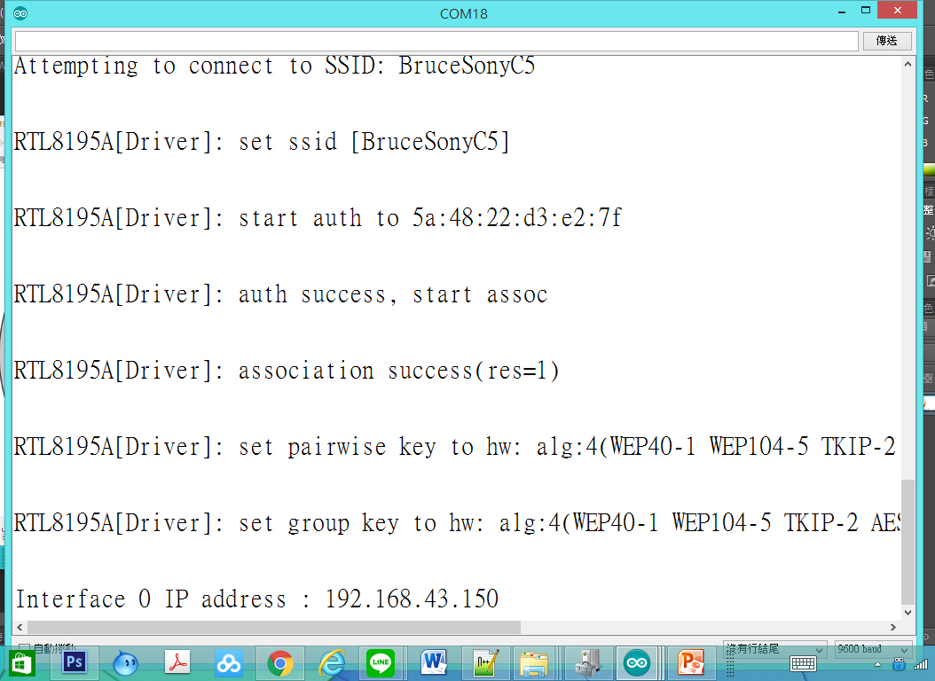
DHT11_Pin7_WIFI_Server_TwoGuage監控畫面
2017/6/24
60

Slide 61
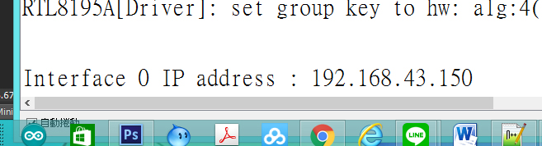
使用瀏覽器進入系統
1.先使用筆電或手機，使用wifi，並將ＷＩＦＩ熱點連接到與Ameba相同的熱點
2.進入瀏覽器(建議使用chrome)
3.網址列輸入上面IP(本例子為：http://192.168.43.150/
2017/6/24
61

Slide 62
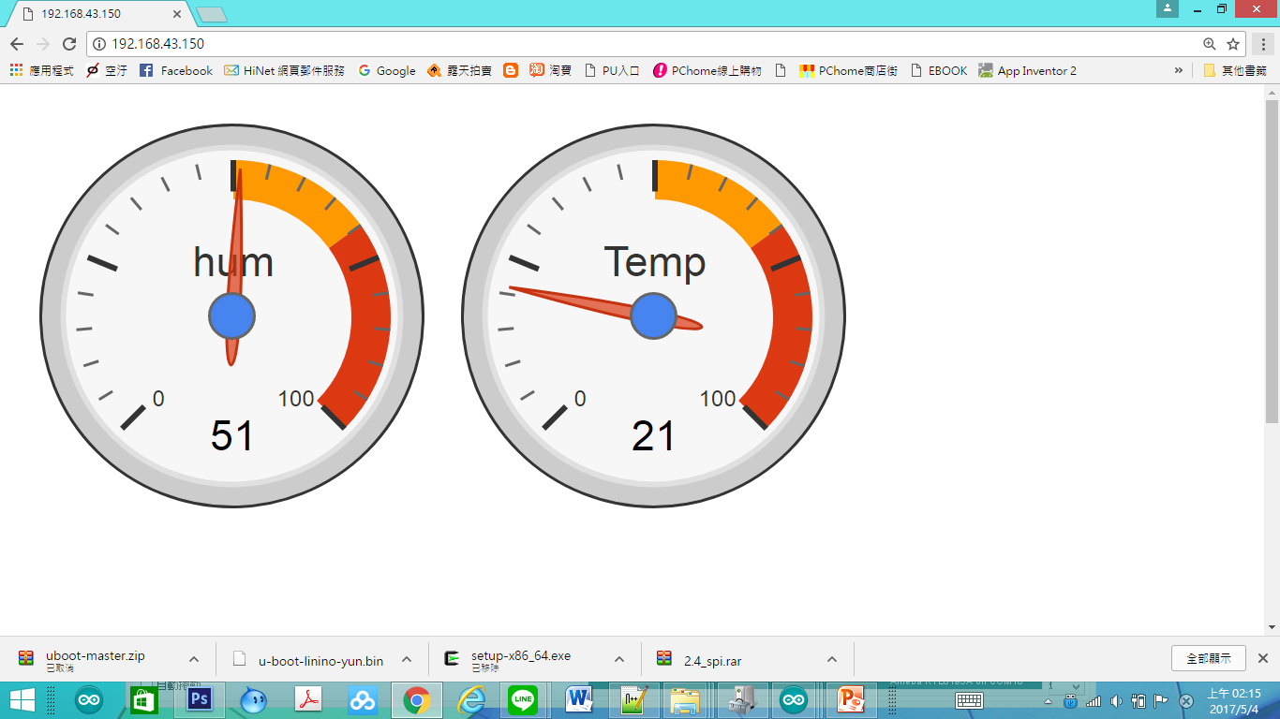
DHT11_Pin7_WIFI_Server_TwoGuage網頁畫面
2017/6/24
62

